Slide 1
Billing for Smart Parking
Instructor: Itzik Ashkenazi
Students: Ran Moshe, Natan Bagrov

Slide 2

Background and Motivation
Finding a parking slot in the Technion has become a cumbersome thing. Employees and many other students are having trouble finding a suitable parking slot for their vehicles.
A Security team ‘guards’ empty parking slots for VIPs when needed.
Waste of time
Waste of money
Notes:
Waste of time in –
Finding a parking slot
Security time
Waste of money in –
Security team
Hitting each other’s cars
Time is money

Slide 3
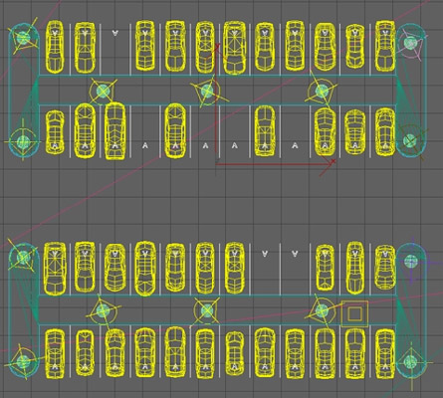
Smart Parking to the rescue!
‘Connecting’ the parking slots to the network
A full view of the status – Online
Registration of Car-IDs to parking slots
Scheduling parking times
More and more…
More time…
More money…
Notes:
More time –
Know where you park
More money –
No security extra
Time is money

Slide 4
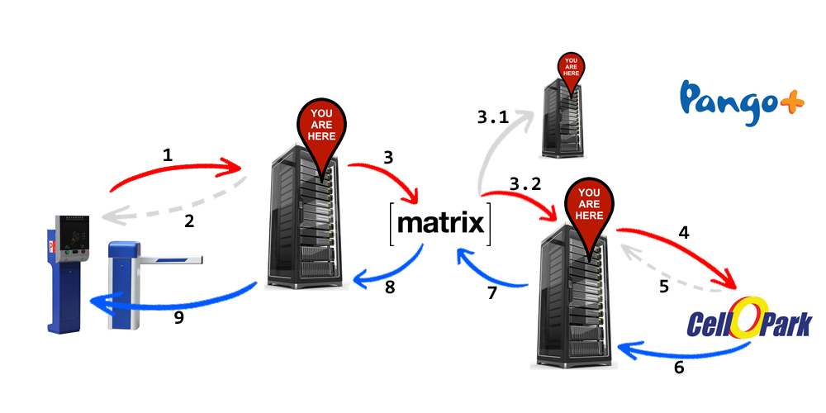
Top Level System Description
Smart Parking Manager Server
The Smart Parking Manager (SPM) will manage the parking lots.
Other parking-providers (CelloPark, Pango) can be used as a billing service
Scalability matters

Slide 5

What Matrix.org is?
Matrix is an open standard for interoperable, decentralized, real-time communication over IP.
Matrix’s goal is to fix the problem of fragmented IP communications
Matrix acts as a generic HTTP messaging and data synchronization system for the whole
Matrix defines and provides the HTTP APIs for transferring JSON messages
Matrix’s community provides open-source implementations of Application Services (like we did)
Notes:
Matrix is an open standard for interoperable, decentralized, real-time communication over IP. It can be used to power Instant Messaging, Internet of Things communication - or anywhere you need a standard HTTP API for publishing and subscribing to data whilst tracking the conversation history.
Matrix’s goal is to fix the problem of fragmented IP communications: letting users message and call each other without having to care what app the other user is on - making it as easy as sending an email.
Matrix acts as a generic HTTP messaging and data synchronization system for the whole web - allowing people, services and devices to easily communicate with each other, empowering users to own and control their data and select the services and vendors they want to use

Slide 6
Top Level System Description
Smart Parking Manager Server
The Matrix
An open standard for decentralized persistent communication.
In other words - A “chat” that everything happens in.
The Bridges
Entities inside the Matrix but with an API to the ‘outside-world’.
Each entity represents a service from the ‘outside-world’.
The ‘outside-world’ services are not dependant on each other, and do not have to ‘know’ each other. The only thing that matters is their Bridge.
Notes:
Scalability matters –
Adding a provider should be simple
Adding another SPM should be simple
Adding 3rd party apps should be simple

Slide 7

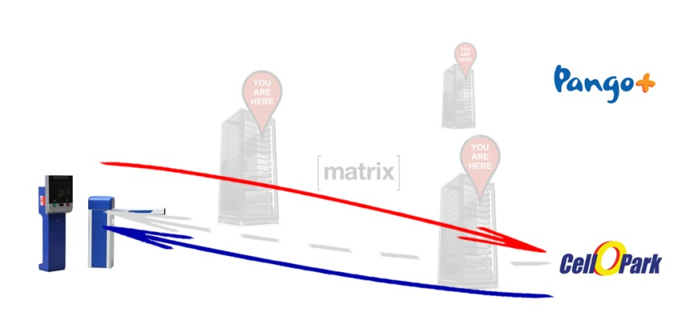


Why Matrix and not direct communication???
More scalable
Apps do not have to ‘know’ each other. They know their corresponding bridge, and that’s all!
Use as many SPMs and Providers as needed
Everything is transparent – Just as a message in the chat
Adding an entity is easy as pie
History and logs are all-in-one-place. with the ability to filter messages by participant
More reliable
Encryption protocols are built inside the Matrix – No need to worry about
Different bridges use different encryption methods with the Providers
Every entity knows what it is responsible for. A protocol change does not result changing the whole communication network
Less scalable
How to add additional SPM?
What to update when adding another provider, with a different API?
What to update if the API changed?
How to add a 3rd party app? Like SMS notifications?
Less reliable
SPM must support all encryption methods the providers support.
SPM must accept a less powerful encryption if the provider uses it
Where the logs are stored? Each server hold its own
Notes:
Adding an Entity is easy as pie
Configure corresponding bridge
Maybe re-configure other bridges
The end-services remain untouched!

Slide 8
Billing for Smart Parking
Smart Parking Manager Server
The Matrix
A matrix home-server runs on Ubuntu 16.10
The Bridges
3 Bridges (SPM, CelloPark, Pango), running on Ubuntu 16.10
Each server (bridge) runs over NodeJS (JavaScript backend)
The SPM
Since no ‘real’ SPM is available yet. We’ve created a Mock to simulate the ‘real’ one.
Runs on Windows 7 x64, over ASP.NET (C# backend)
The providers (CelloPark and Pango)
Since no API was given by the providers, We’ve created a Mock to simulate each provider.
Runs on Windows 7 x64, over ASP.NET (C# backend)

Slide 9

Project stages
The Matrix
Setting up the Matrix
The Bridges
Installing NodeJS
Adding a matrix-appbridge-service Framework support
Running 3 NodeJS servers
The SPM & The Providers
Writing 3 mocks (C#), with basic logic for PoC
All mocks run on single IIS Server, they defer in their API address

Slide 10
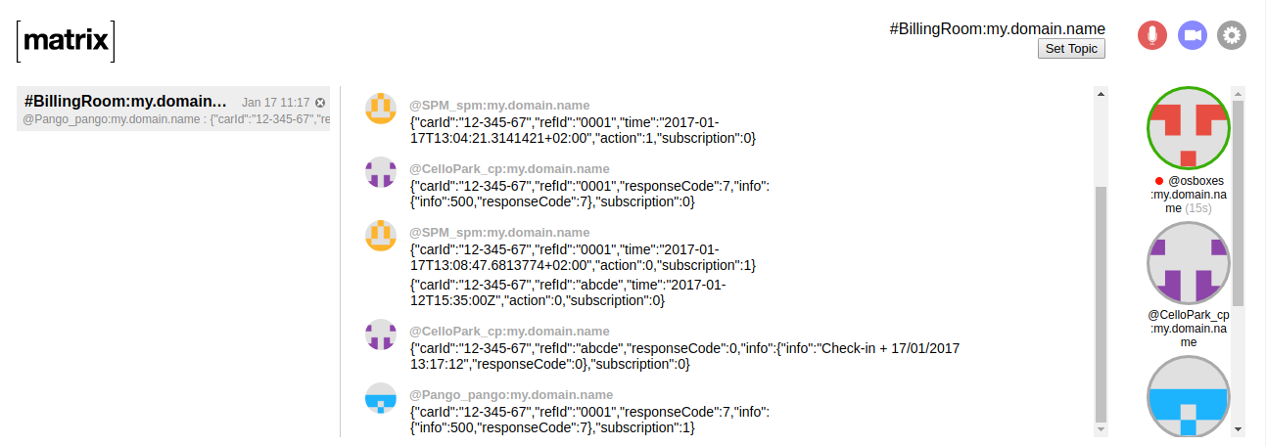
What Matrix looks like…
The Matrix ‘room’
Every entity is a bridge
Can add supervisors (human)
Connect from where-ever you are
Everything works by sending and receiving JSON Objects over HTTP

Slide 11
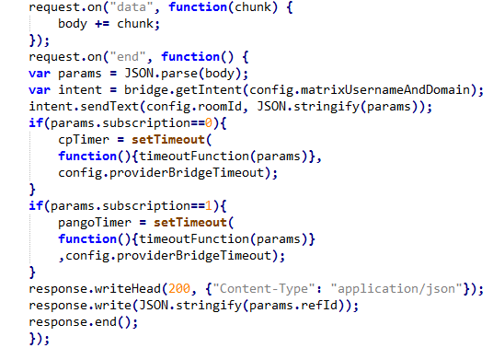
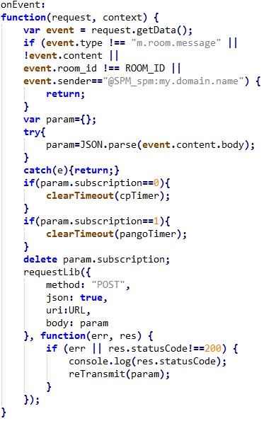
What A Bridge looks like…
External API
Callback function
The Bridge
An entity in the Matrix room
Uses Matrix’s API to post to the matrix
Runs over NodeJS, JavaScript backend
Provides call-back functions to the Matrix in-order to be updated when a new message happens to appear
Exposes an API (JSON over HTTP) to the external service(s) (SPM, CelloPark, Pango, etc…)
Uses an API (JSON over HTTP) given by the external service(s) to post to it

Slide 12
Everything put-together
1 | A car checks-out. SPM posts to SPM-bridge: { refId: 1234567, carId: 12-345-67, time: 2016-12-26T21:35:00Z, subscription: 0, action: 1 }
2 | SPM-bridge gets this message and returns status code: 200 (OK) with the refId as the body of the response: { 1234567 }
3 | SPM-bridge writes the request (from the SPM) into the Matrix: { refId: 1234567, carId: 12-345-67, time: 2016-12-26T21:35:00Z, subscription: 0, action: 1 }
3.1 | The message is read by all of the participants. Bridges that are not responsible for Cellopark read the message and ignore it
3.2 | Cellopark-bridge reads the message that is delivered to it
4 | Cellopark-bridge re-formats the message and sends it to the provider (Cellopark): { refId: 1234567, carId: 12-345-67, time: 2016-12-26T21:35:00Z }
5 | Cellopark-bridge gets a response from the provider. If this response means to wait for a post from the provider with the actual instruction, it waits
6 | The provider posts the action to the Cellopark-bridge: { refId: 1234567 }
7 | Cellopark-bridge re-formats the action and writes it to the Matrix: { refId: 123456720161226213500, carId: 12-345-67, status: 0, info: { info: “ok” responseCode: 0 }
8 | SPM-bridge reads the message with the action from the provider (via the bridge)
9 | SPM-bridge re-formats the message and sends it to the SPM: { refId: 123456720161226213500, carId: 12-345-67, status: 0, info: { info: “ok” responseCode: 0 }, and once the SPM receives it - the gate opens

Slide 13
Demo
Normal behavior:
A car checks-in, CelloPark
A car checks-in, Pango
A car checks-out, CelloPark
A car checks-out, Pango
Illegal cases:
Car was not found
A car that is not checked-in tries to check-out
Exceptions:
Provider (CelloPark, or Pango if you like) is down
Provider-bridge (Pango, or CelloPark if you like) is down
The SPM server is down

Slide 14
Load Test
Our test consists of simple .exe file:
This executable POSTs to the SPM Mock events of car check-ins/outs.
./Exe.exe <uri> <number of requests> <interval between requests in milliseconds>

Slide 15
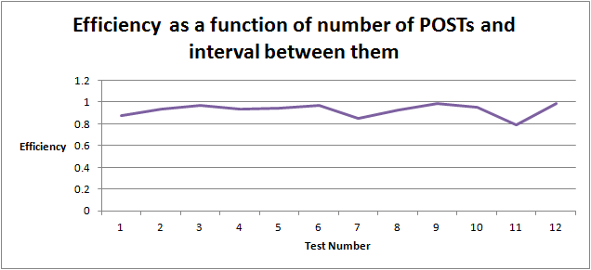
Results and conclusions
Test # | Number of POSTs | Interval (in ms) | Timer (in seconds)
1 | 1 | 1000 | 1.14
2 | 2 | 1000 | 2.14
3 | 5 | 1000 | 5.14
4 | 10 | 1000 | 10.67
5 | 5 | 500 | 2.64
6 | 10 | 500 | 5.14
7 | 5 | 200 | 1.18
8 | 10 | 200 | 2.15
9 | 20 | 500 | 10.16
10 | 50 | 500 | 26.18
11 | 100 | 500 | 63.37
12 | 500 | 1000 | 507.23
The efficiency is high and stable.
There is a minor delay on the first POST. Probably because of a cooldown.
After some period of time, the bridges return “Too many requests” - this limitation comes from Matrix.org homeserver.
Configure in the Matrix.org homeserver.yaml the field: rc_messages_per_second

Slide 16
Future plans and opportunities
Integration with REAL services
SPM server
CelloPark and Pango
Extending the current solution
Adding more billing providers
Adding more SPMs
Version hand-shake between Matrix, bridges and the SPM and auto-upgrade if needed

Slide 17
Questions?

Slide 18

Thank you!

